Slide 1

Chapter 3
Transport Layer
A note on the use of these PowerPoint slides:
We’re making these slides freely available to all (faculty, students, readers). They’re in PowerPoint form so you see the animations; and can add, modify, and delete slides (including this one) and slide content to suit your needs. They obviously represent a lot of work on our part. In return for use, we only ask the following:
If you use these slides (e.g., in a class) that you mention their source (after all, we’d like people to use our book!)
If you post any slides on a www site, that you note that they are adapted from (or perhaps identical to) our slides, and note our copyright of this material.
For a revision history, see the slide note for this page.
Thanks and enjoy! JFK/KWR
All material copyright 1996-2025
J.F Kurose and K.W. Ross, All Rights Reserved
Computer Networking: A Top-Down Approach
9th edition
Jim Kurose, Keith Ross
Pearson, 2025
Notes:
Version 9.0: updated to 9th Edition, June 2025

Slide 2

Chapter 3: roadmap
Transport-layer services
Multiplexing and demultiplexing
Connectionless transport: UDP
Principles of reliable data transfer
Connection-oriented transport: TCP
  segment structure
  reliable data transfer
  flow control
  connection management
Principles of congestion control
TCP congestion control

Slide 3
TCP: overview RFCs: 793,1122, 2018, 5681, 7323
point-to-point:
    one sender, one receiver
reliable, in-order byte stream:
    no “message boundaries"
full duplex data:
  bi-directional data flow in same connection
  MSS: maximum segment size
cumulative ACKs
pipelining:
    TCP congestion and flow control set window size
connection-oriented:
  handshaking (exchange of control messages) initializes sender, receiver state before data exchange
flow controlled:
  sender will not overwhelm receiver
Notes:
Typical MSS is 1460 bytes

Slide 4
TCP segment structure
32 bits
source port #
dest port #
segment seq #: counting bytes of data into bytestream (not segments!)
ACK: seq # of next expected byte; A bit: this is an ACK
sequence number
acknowledgement number
length (of TCP header)
head
len
not
used
A
P
S
receive window
flow control: # bytes receiver willing to accept
C
E
U
R
F
Internet checksum
checksum
Urg data pointer
options (variable length)
C, E: congestion notification
TCP options
application
data
(variable length)
data sent by application into TCP socket
RST, SYN, FIN: connection management

Slide 5
TCP sequence numbers, ACKs
outgoing segment from sender
Sequence numbers:
  byte stream “number” of first byte in segment’s data
source port #
dest port #
sequence number
acknowledgement number
rwnd
checksum
urg pointer
window size
N
Acknowledgements:
  seq # of next byte expected from other side
  cumulative ACK
  sender sequence number space
sent
ACKed
sent, not-yet ACKed
(“in-flight”)
usable
but not
yet sent
not
usable
Q: how receiver handles out-of-order segments
  A: TCP spec doesn’t say, - up to implementor
outgoing segment from receiver
source port #
dest port #
sequence number
acknowledgement number
A
rwnd
checksum
urg pointer

Slide 6

TCP sequence numbers, ACKs
Host A
Host B
User types‘C’
Seq=42, ACK=79, data = ‘C’
host ACKs receipt of‘C’, echoes back ‘C’
Seq=79, ACK=43, data = ‘C’
host ACKs receipt of echoed ‘C’
Seq=43, ACK=80
simple telnet scenario
Notes:
The key thing to note here is that the ACK number (43) on the B-to-A segment is one more than the sequence number (42) on the A-to-B segment that triggered that ACK
Similarly, the ACK number (80) on the last A-to-B segment is one more than the sequence number (79) on the B-to-A segment that triggered that ACK

Slide 7
TCP round trip time, timeout
Q: how to set TCP timeout value?
longer than RTT, but RTT varies!
too short: premature timeout, unnecessary retransmissions
too long: slow reaction to segment loss
Q: how to estimate RTT?
SampleRTT:measured time from segment transmission until ACK receipt
  ignore retransmissions
SampleRTT will vary, want estimated RTT “smoother”
  average several recent measurements, not just current SampleRTT

Slide 8
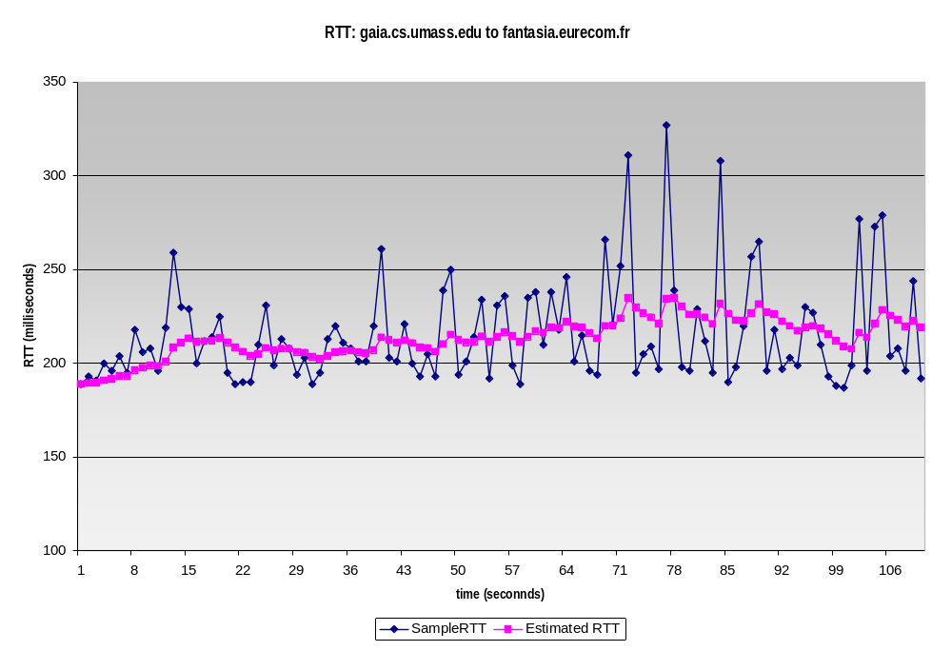
TCP round trip time, timeout
EstimatedRTT = (1- α)*EstimatedRTT + α*SampleRTT
exponential weighted moving average (EWMA)
influence of past sample decreases exponentially fast
typical value: α = 0.125
RTT: gaia.cs.umass.edu to fantasia.eurecom.fr
RTT (milliseconds)
sampleRTT
EstimatedRTT
time (seconds)
Notes:
This is how TCP re-computes the estimated RTT each time a new SampleRTT is taken.
The process is knows as an exponentially weighted moving average, shown by the equation here.
<say it>
Where alpha reflects the influence of the most recent measurements on the estimated RTT; a typical value of alpha used in implementations is .125
The graph at the bottom show measured RTTs between a host in the Massachusetts and a host in France, as well as the estimated, “smoothed” RTT

Slide 9

TCP round trip time, timeout
timeout interval: EstimatedRTT plus “safety margin”
  large variation in EstimatedRTT: want a larger safety margin
TimeoutInterval = EstimatedRTT + 4*DevRTT
estimated RTT
“safety margin”
DevRTT: EWMA of SampleRTT deviation from EstimatedRTT:
DevRTT = (1-β)*DevRTT + β*|SampleRTT-EstimatedRTT|
(typically, β = 0.25)
* Check out the online interactive exercises for more examples: http://gaia.cs.umass.edu/kurose_ross/interactive/
Notes:
Given this value of the estimated RTT, TCP computes the timeout interval to be the estimated RTT plus a “safety margin”
And the intuition is that if we are seeing a large variation in SAMPLERTT – the RTT estimates are fluctuating a lot - then we’ll want a larger safety margin
So TCP computes the Timeout interval to be the Estimated RTT plus 4 times a measure of deviation in the RTT.
The deviation in the RTT is computed as the eWMA of the difference between the most recently measured SampleRTT from the Estimated RTT

Slide 10
Example
Suppose that TCP's current estimated values for the round trip time (estimatedRTT) and deviation in the RTT (DevRTT) are 370 msec and 45 msec, respectively. Suppose that the next three measured values of the RTT are 380 msec, 390 msec, and 340 msec respectively.
Use the values of α = 0.125, and β = 0.25. Round your answers to two decimal places after leading zeros.
1. What is the estimatedRTT after the first RTT?
2. What is the RTT Deviation for the the first RTT?
3. What is the TCP timeout for the first RTT?
4. What is the estimatedRTT after the second RTT?
5. What is the RTT Deviation for the the second RTT?
6. What is the TCP timeout for the second RTT?
7. What is the estimatedRTT after the third RTT?
8. What is the RTT Deviation for the the third RTT?
9. What is the TCP timeout for the third RTT?

Slide 11
Solution
DevRTT is calculated with the following equation: (1-beta)*DevRTT + beta * |estimatedRTT - sampleRTT|
estimatedRTT is calculated with the following equation: (1-alpha)*estimatedRTT + alpha*sampleRTT
TCP timeout is calculated with the following equation: estimatedRTT + (4*DevRTT)
1. The estimatedRTT for RTT1 is 371.25
2. The DevRTT for RTT1 is 36.25
3. The timeout for RTT1 is 516.25
4. The estimatedRTT for RTT2 is 373.59
5. The DevRTT for RTT2 is 31.88
6. The timeout for RTT2 is 501.09
7. The estimatedRTT for RTT3 is 369.39
8. The DevRTT for RTT3 is 32.3
9. The timeout for RTT3 is 498.61

Slide 12
TCP Sender (simplified)
event: data received from application
create segment with seq #
seq # is byte-stream number of first data byte in segment
start timer if not already running
  think of timer as for oldest unACKed segment
  expiration interval: TimeOutInterval
event: timeout
retransmit segment that caused timeout
restart timer
event: ACK received
if ACK acknowledges previously unACKed segments
  update what is known to be ACKed
  start timer if there are still unACKed segments
Notes:
Given these details of TCP sequence numbers, acks, and timers, we can now describe the big picture view of how the TCP sender and receiver operate
You can check out FSMs in book; let’s just give an English text description here and let’s start with the sender.

Slide 13
TCP Receiver: ACK generation [RFC 5681]
Event at receiver
arrival of in-order segment with
expected seq #. All data up to
expected seq # already ACKed
arrival of in-order segment with
expected seq #. One other
segment has ACK pending
arrival of out-of-order segment
higher-than-expect seq. # .
Gap detected
arrival of segment that
partially or completely fills gap
TCP receiver action
delayed ACK. Wait up to 500ms
for next segment. If no next segment,
send ACK
immediately send single cumulative
ACK, ACKing both in-order segments
immediately send duplicate ACK (acking
last correctly received in order byte),
indicating seq. # of next expected byte
immediate send ACK, provided that
segment starts at lower end of gap
Notes:
Rather than immediately Acknowledging this segment, many TCP implementations will wait for half a second for another in-order segment to arrive, and then generate a single cumulative ACK for both segments – thus decreasing the amount of ACK traffic. The arrival of this second in-order segment and the cumulative ACK generation that covers both segments is the second row in this table.

Slide 14
TCP: retransmission scenarios
Host A
Host B
Host A
Host B
SendBase=92
Seq=92, 8 bytes of data
Seq=92, 8 bytes of data
timeout
timeout
Seq=100, 20 bytes of data
ACK=100
X
ACK=100
ACK=120
Seq=92, 8 bytes of data
Seq=92, 8
bytes of data
SendBase=100
send cumulative
ACK for 120
SendBase=120
ACK=100
ACK=120
SendBase=120
lost ACK scenario
premature timeout
Notes:
To cement our understanding of TCP reliability, let’s look a a few retransmission scenarios
In the first case a TCP segments is transmitted and the ACK is lost, and the TCP timeout mechanism results in another copy of being transmitted and then re-ACKed a the sender
In the second example two segments are sent and acknowledged, but there is a premature timeout e for the first segment, which is retransmitted. Note that when this retransmitted segment is received, the receiver has already received the first two segments, and so resends a cumulative ACK for both segments received so far, rather than an ACK for just this fist segment.

Slide 15
TCP: retransmission scenarios
Host A
Host B
Seq=92, 8 bytes of data
Seq=100, 20 bytes of data
ACK=100
X
ACK=120
Seq=120, 15 bytes of data
cumulative ACK covers for earlier lost ACK
Notes:
And in this last example, two segments are again transmitted, the first ACK is lost but the second ACK, a cumulative ACK arrives at the sender, which then can transmit a third segment, knowing that the first two have arrived, even though the ACK for the first segment was lost

Slide 16

TCP fast retransmit
Host A
Host B
TCP fast retransmit
if sender receives 3 additional ACKs for same data (“triple duplicate ACKs”), resend unACKed segment with smallest seq #
  likely that unACKed segment lost, so don’t wait for timeout
Seq=92, 8 bytes of data
Seq=100, 20 bytes of data
X
ACK=100
timeout
ACK=100
ACK=100
Receipt of three duplicate ACKs indicates 3 segments received after a missing segment – lost segment is likely. So retransmit!
ACK=100
Seq=100, 20 bytes of data
Notes:
Let’s wrap up our study of TCP reliability by discussing an optimization to the original TCP known as TCP fast retransmit,
Take a look at this example on the right where 5 segments are transmitted and the second segment is lost. In this case the TCP receiver sends an ACK 100 acknowledging the first received segment.
When the third segment arrives at the receiver, the TCP receiver sends another ACK 100 since the second segment has not arrived. And similarly for the 4th and 5th segments to arrive.
Now what does the sender see? The sender receives the first ACK 100 it has been hoping for, but then three additional duplicate ACK100s arrive. The sender knows that somethings’ wrong – it knows the first segment arrived at the receiver but three later arriving segments at the receiver – the ones that generated the three duplicate ACKs – we received correctly but were not in order. That is, that there was a missing segment at the receiver when each of the three duplicate ACK were generated.
With fast retransmit, the arrival of three duplicate ACK causes the sender to retransmit its oldest unACKed segment, without waiting for a timeout event. This allows TCP to recover more quickly from what is very likely a loss event
specifically that the second segment has been lost, since three higher -numbered segments were received

Slide 17
Chapter 3: roadmap
Transport-layer services
Multiplexing and demultiplexing
Connectionless transport: UDP
Principles of reliable data transfer
Connection-oriented transport: TCP
  segment structure
  reliable data transfer
  flow control
  connection management
Principles of congestion control
TCP congestion control

Slide 18
TCP flow control
application
process
Q: What happens if network layer delivers data faster than application layer removes data from socket buffers?
Application removing data from TCP socket buffers
TCP socket
receiver buffers
TCP
code
Network layer delivering IP datagram payload into TCP socket buffers
IP
code
from sender
receiver protocol stack
Notes:
(Presuming an intro)
Before diving into the details of TCP flow control, let’s first get the general context and motivate the need for flow control.
This diagram show a typical transport-layer implementation
A segment is brought up the protocol stack to the transport layer, and the segment’s payload is removed from the segment and written INTO socket buffers.
How does data get taken OUT of socket buffers? By applications performing socket reads, as we learned in Chapter 2.
And so the question is “What happens if network layer delivers data faster than an application-layer process removes data from socket buffers?”
Let’s watch a video of what happens when things arrive way too fast to fast to be processed.
<video>. (I love that video). Another human analogy showing the need for flow control is the saying – to use some English slang - “no one can drink from a firehose”
Flow control is a mechanism to the calamity of a receiver being over-run by a sender that is sending too fast – it allows the RECEIVER to explicitly control the SENDER so sender won’t overflow receiver’s buffer by transmitting too much, too fast

Slide 19
TCP flow control
application
process
Q: What happens if network layer delivers data faster than application layer removes data from socket buffers?
Application removing data from TCP socket buffers
TCP socket
receiver buffers
TCP
code
Network layer delivering IP datagram payload into TCP socket buffers
IP
code
from sender
receiver protocol stack
Notes:
(Presuming an intro)
Before diving into the details of TCP flow control, let’s first get the general context and motivate the need for flow control.
This diagram show a typical transport-layer implementation
A segment is brought up the protocol stack to the transport layer, and the segment’s payload is removed from the segment and written INTO socket buffers.
How does data get taken OUT of socket buffers? By applications performing socket reads, as we learned in Chapter 2.
And so the question is “What happens if network layer delivers data faster than an application-layer process removes data from socket buffers?”
Let’s watch a video of what happens when things arrive way too fast to fast to be processed.
<video>. (I love that video). Another human analogy showing the need for flow control is the saying – to use some English slang - “no one can drink from a firehose”
Flow control is a mechanism to the calamity of a receiver being over-run by a sender that is sending too fast – it allows the RECEIVER to explicitly control the SENDER so sender won’t overflow receiver’s buffer by transmitting too much, too fast

Slide 20
TCP flow control
application
process
Q: What happens if network layer delivers data faster than application layer removes data from socket buffers?
Application removing data from TCP socket buffers
TCP socket
receiver buffers
TCP
code
receive window
flow control: # bytes receiver willing to accept
IP
code
from sender
receiver protocol stack
Notes:
(Presuming an intro)
Before diving into the details of TCP flow control, let’s first get the general context and motivate the need for flow control.
This diagram show a typical transport-layer implementation
A segment is brought up the protocol stack to the transport layer, and the segment’s payload is removed from the segment and written INTO socket buffers.
How does data get taken OUT of socket buffers? By applications performing socket reads, as we learned in Chapter 2.
And so the question is “What happens if network layer delivers data faster than an application-layer process removes data from socket buffers?”
Let’s watch a video of what happens when things arrive way too fast to fast to be processed.
<video>. (I love that video). Another human analogy showing the need for flow control is the saying – to use some English slang - “no one can drink from a firehose”
Flow control is a mechanism to the calamity of a receiver being over-run by a sender that is sending too fast – it allows the RECEIVER to explicitly control the SENDER so sender won’t overflow receiver’s buffer by transmitting too much, too fast

Slide 21
TCP flow control
application
process
Q: What happens if network layer delivers data faster than application layer removes data from socket buffers?
Application removing data from TCP socket buffers
TCP socket
receiver buffers
TCP
code
flow control
receiver controls sender, so sender won’t overflow receiver’s buffer by transmitting too much, too fast
IP
code
from sender
receiver protocol stack
Notes:
(Presuming an intro)
Before diving into the details of TCP flow control, let’s first get the general context and motivate the need for flow control.
This diagram show a typical transport-layer implementation
A segment is brought up the protocol stack to the transport layer, and the segment’s payload is removed from the segment and written INTO socket buffers.
How does data get taken OUT of socket buffers? By applications performing socket reads, as we learned in Chapter 2.
And so the question is “What happens if network layer delivers data faster than an application-layer process removes data from socket buffers?”
Let’s watch a video of what happens when things arrive way too fast to fast to be processed.
<video>. (I love that video). Another human analogy showing the need for flow control is the saying – to use some English slang - “no one can drink from a firehose”
Flow control is a mechanism to the calamity of a receiver being over-run by a sender that is sending too fast – it allows the RECEIVER to explicitly control the SENDER so sender won’t overflow receiver’s buffer by transmitting too much, too fast

Slide 22
TCP flow control
TCP receiver “advertises” free buffer space in rwnd field in TCP header
  RcvBuffer size set via socket options (typical default is 4096 bytes)
  many operating systems auto-adjust RcvBuffer
sender limits amount of unACKed (“in-flight”) data to received rwnd
guarantees receive buffer will not overflow
to application process
RcvBuffer
buffered data
rwnd
free buffer space
TCP segment payloads
TCP receiver-side buffering
Notes:
Here’s how TCP implement flow control. The basic idea is simple – the receiver informs the sender how much free buffer space there is, and the sender is limited to send no more than this amount of data. That the value o RWND in the diagram to the right.
This information is carried from the receiver to the sender in the “receiver advertised window” (do a PIP of header) in the TCP header, and the value will change as the amount of free buffer space fluctuates over time.

Slide 23
TCP flow control
flow control: # bytes receiver willing to accept
TCP receiver “advertises” free buffer space in rwnd field in TCP header
  RcvBuffer size set via socket options (typical default is 4096 bytes)
  many operating systems auto-adjust RcvBuffer
sender limits amount of unACKed (“in-flight”) data to received rwnd
guarantees receive buffer will not overflow
receive window
TCP segment format
Notes:
Here’s how TCP implement flow control. The basic idea is simple – the receiver informs the sender how much free buffer space there is, and the sender is limited to send no more than this amount of data. That the value o RWND in the diagram to the right.
This information is carried from the receiver to the sender in the “receiver advertised window” (do a PIP of header) in the TCP header, and the value will change as the amount of free buffer space fluctuates over time.

Slide 24
TCP Flow Control - Silly Window Syndrome
Recall: TCP uses sliding window
“Silly Window” occurs when small-sized segments are transmitted, resulting in inefficient use of the network pipe
For e.g., suppose that TCP sender generates data slowly, 1-byte at a time
Sending 1 byte of data + 20 byte TCP header!!!
Solution: wait until sender has enough data to transmit – “Nagle’s Algorithm”

Slide 25
Nagle’s Algorithm
1. TCP sender sends the first piece of data obtained from the application (even if data is only a few bytes).
2. Wait until enough bytes have accumulated in the TCP send buffer
OR
until an ACK is received.
3. Repeat step 2 for the remainder of the transmission.

Slide 26
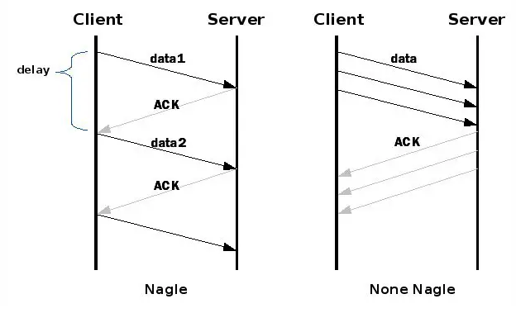
Working of Nagle’s Algorithm

Slide 27
Silly Window Continued …
Suppose that the receiver App consumes data slowly
  Receive Window opens slowly (e.g. 1 byte), and thus sender is forced to send small-sized segments
Clark’s Solution
  Delayed ACK until sufficient amount of buffer is available in receive window buffer…. Issues??
  OR
  Send ACK immediately BUT Advertise Receive Window = 0, until reasonable amount of space available in receiver’s buffer

Slide 28
TCP connection management
before exchanging data, sender/receiver “handshake”:
agree to establish connection (each knowing the other willing to establish connection)
agree on connection parameters (e.g., starting seq #s)
application
application
connection state: ESTAB
connection variables:
  seq # client-to-server
  server-to-client
  rcvBuffer size
  at server,client
connection state: ESTAB
connection Variables:
  seq # client-to-server
  server-to-client
  rcvBuffer size
  at server,client
network
network
Socket clientSocket =
newSocket("hostname","port number");
Socket connectionSocket = welcomeSocket.accept();
Notes:
The other TCP topic we’ll want to consider here is that of “connection management”
The TCP sender and receiver have a number of pieces of shared state that they must establish before actually communicating
FIRST they must both agree that they WANT to communicate with each other
Secondly there are connection parameters – the initial sequence number and the initial receiver-advertised bufferspace that they’ll want to agree on
This is done via a so-called handshake protocol – the client reaching our to the server, and the server answering back.
And before diving into the TCP handshake protocol, let’s first consider the problem of handshaking, of establishing shared state.

Slide 29


Agreeing to establish a connection
2-way handshake:
Q: will 2-way handshake always work in network?
variable delays
retransmitted messages (e.g. req_conn(x)) due to message loss
message reordering
can’t “see” other side
Let’s talk
ESTAB
OK
ESTAB
choose x
req_conn(x)
ESTAB
acc_conn(x)
ESTAB
Notes:
Here’s an example of a two way handshake. Alice reaches out to Bob and say’s “let’s talk” and Bob says OK, and they start their conversation
For a network protocol, the equivalent protocol would be a client sending a “request connection” message saying ”let’s talk, the initial sequence number is x”
And the server would respond with a message ”I accept your connect x”
And the question we want to ask ourselves is <talk through>
Will this work? Let’s look at a few scenarios…

Slide 30

2-way handshake scenarios
choose x
req_conn(x)
ESTAB
acc_conn(x)
ESTAB
data(x+1)
accept
data(x+1)
ACK(x+1)
connection
x completes
No problem!

Slide 31

2-way handshake scenarios
choose x
req_conn(x)
ESTAB
retransmit
req_conn(x)
acc_conn(x)
ESTAB
req_conn(x)
connection
x completes
client terminates
server
forgets x
ESTAB
acc_conn(x)
Problem: half open connection! (no client)

Slide 32
2-way handshake scenarios
choose x
req_conn(x)
ESTAB
retransmit
req_conn(x)
acc_conn(x)
ESTAB
data(x+1)
accept
data(x+1)
retransmit
data(x+1)
connection
x completes
client terminates
server
forgets x
req_conn(x)
ESTAB
data(x+1)
accept
data(x+1)
Problem: dup data
accepted!

Slide 33
TCP 3-way handshake
Server state
Client state
serverSocket = socket(AF_INET,SOCK_STREAM)
serverSocket.bind((‘’,serverPort))
serverSocket.listen(1)
connectionSocket, addr = serverSocket.accept()
clientSocket = socket(AF_INET, SOCK_STREAM)
LISTEN
clientSocket.connect((serverName,serverPort))
LISTEN
choose init seq num, x
send TCP SYN msg
SYNSENT
SYNbit=1, Seq=x
choose init seq num, y
send TCP SYNACK
msg, acking SYN
SYN RCVD
SYNbit=1, Seq=y
ACKbit=1; ACKnum=x+1
received SYNACK(x)
indicates server is live;
send ACK for SYNACK;
this segment may contain
client-to-server data
ESTAB
ACKbit=1, ACKnum=y+1
received ACK(y)
indicates client is live
ESTAB
Notes:
TCP’s three way handshake, that operates as follows
Let’s say the client and server both create a TCP socket as we learned about in Chapter 2 and enter the LISTEN state
The client then connects to the server sending a SYN message with a sequence number x (SYN Message is an TCP Segment with SYN but set in the header – you might want to go back and review the TCP segment format!)
The server is waiting for a connection, and receives the SYN message enters the SYN received state (NOT the established state and sends a SYN ACK message back.
Finally the client sends an ACK message to the server, and when the server receiver this enters the Established state. This is when the application process would see the return from the wait on the socket accept() call

Slide 34
Closing a TCP connection
client, server each close their side of connection
  send TCP segment with FIN bit = 1
respond to received FIN with ACK
  on receiving FIN, ACK can be combined with own FIN
simultaneous FIN exchanges can be handled
Notes:
All good things must come to an end, and that’s true for a TCP connection as well.
And of course there’s a protocol for one side to gracefully close of a TCP connection using a FIN message, to which the other side sends a FINACK message and waits around a bit to respond to any retransmitted FIN messages before timing out.

Slide 35
Chapter 3: roadmap
Transport-layer services
Multiplexing and demultiplexing
Connectionless transport: UDP
Principles of reliable data transfer
Connection-oriented transport: TCP
Principles of congestion control
TCP congestion control
Evolution of transport-layer functionality

Slide 36

Principles of congestion control
Congestion:
informally: “too many sources sending too much data too fast for network to handle”
manifestations:
  long delays (queueing in router buffers)
  packet loss (buffer overflow at routers)
different from flow control!
congestion control: too many senders, sending too fast
a top-10 problem!
flow control: one sender too fast for one receiver

Slide 37
Causes/costs of congestion: scenario 1
original data: λ_{in}
throughput: λ_{out}
Simplest scenario:
Host A
one router, infinite buffers
input, output link capacity: R
infinite shared output link buffers
two flows
R
R
no retransmissions needed
Host B
R/2
Q: What happens as arrival rate λ_{in} approaches R/2?
λ_{out}
delay
throughput:
λ_{in}
R/2
λ_{in}
R/2
maximum per-connection throughput: R/2
large delays as arrival rate λ_{in} approaches capacity
R/2

Slide 38
Causes/costs of congestion: scenario 2
one router, finite buffers
sender retransmits lost, timed-out packet
  application-layer input = application-layer output: λ_{in} = λ_{out}
  transport-layer input includes retransmissions : λ’_{in} λ_{in}
Host A
λ_{in} : original data
λ'_{in}: original data, plus retransmitted data
λ_{out}
R
R
Host B
finite shared output link buffers

Slide 39
Causes/costs of congestion: scenario 2
Idealization: perfect knowledge
sender sends only when router buffers available
R/2
λ_{out}
throughput:
Host A
λ_{in} : original data
λ_{in}
copy
λ'_{in}: original data, plus retransmitted data
λ_{out}
R/2
free buffer space!
R
R
Host B
finite shared output link buffers

Slide 40
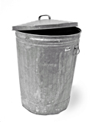
Causes/costs of congestion: scenario 2
Idealization: some perfect knowledge
packets can be lost (dropped at router) due to full buffers
sender knows when packet has been dropped: only resends if packet known to be lost
Host A
λ_{in} : original data
copy
λ'_{in}: original data, plus retransmitted data
no buffer space!
R
R
Host B
finite shared output link buffers

Slide 41
Causes/costs of congestion: scenario 2
Idealization: some perfect knowledge
packets can be lost (dropped at router) due to full buffers
sender knows when packet has been dropped: only resends if packet known to be lost
R/2
λ_{out}
“wasted” capacity due to retransmissions
when sending at R/2, some packets are needed retransmissions
throughput:
Host A
λ_{in} : original data
λ_{in}
λ'_{in}: original data, plus retransmitted data
R/2
free buffer space!
R
R
Host B
finite shared output link buffers

Slide 42


Causes/costs of congestion: scenario 2
Realistic scenario: un-needed duplicates
packets can be lost, dropped at router due to full buffers – requiring retransmissions
but sender times can time out prematurely, sending two copies, both of which are delivered
R/2
λ_{out}
“wasted” capacity due to un-needed retransmissions
throughput:
when sending at R/2, some packets are retransmissions, including needed and un-needed duplicates, that are delivered!
Host A
λ_{in} : original data
λ_{in}
copy
λ'_{in}: original data, plus retransmitted data
R/2
timeout
free buffer space!
R
R
Host B
finite shared output link buffers

Slide 43
Causes/costs of congestion: scenario 2
Realistic scenario: un-needed duplicates
packets can be lost, dropped at router due to full buffers – requiring retransmissions
but sender times can time out prematurely, sending two copies, both of which are delivered
R/2
λ_{out}
“wasted” capacity due to un-needed retransmissions
throughput:
when sending at R/2, some packets are retransmissions, including needed and un-needed duplicates, that are delivered!
λ_{in}
R/2
“costs” of congestion:
more work (retransmission) for given receiver throughput
unneeded retransmissions: link carries multiple copies of a packet
  decreasing maximum achievable throughput

Slide 44
Causes/costs of congestion: scenario 3
four senders
multi-hop paths
timeout/retransmit
Q: what happens as λ_{in} and λ_{in}’ increase ?
A: as red λ_{in}’ increases, all arriving blue pkts at upper queue are dropped, blue throughput g 0
Host A
λ_{in} : original data
λ'_{in}: original data, plus retransmitted data
Host B
finite shared output link buffers
Host D
λ_{out}
Host C

Slide 45
Causes/costs of congestion: scenario 3
R/2
λ_{out}
λ_{in}’
R/2
another “cost” of congestion:
when packet dropped, any upstream transmission capacity and buffering used for that packet was wasted!

Slide 46
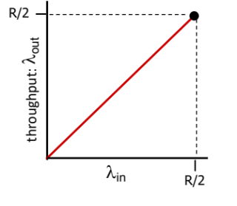
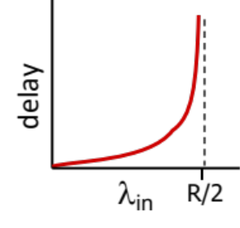
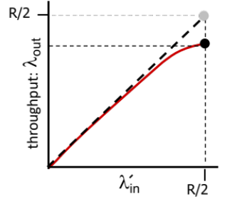
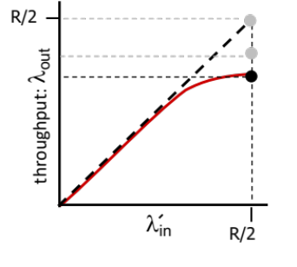
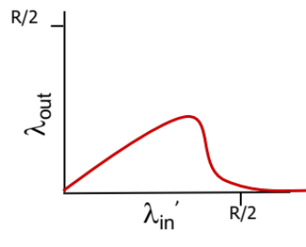
Causes/costs of congestion: insights
throughput can never exceed capacity
delay increases as capacity approached
loss/retransmission decreases effective throughput
un-needed duplicates further decreases effective throughput
upstream transmission capacity / buffering wasted for packets lost downstream

Slide 47
Approaches towards congestion control
End-end congestion control:
no explicit feedback from network
congestion inferred from observed loss, delay
ACKs
data
data
ACKs
approach taken by TCP

Slide 48
Approaches towards congestion control
Network-assisted congestion control:
routers provide direct feedback to sending/receiving hosts with flows passing through congested router
may indicate congestion level or explicitly set sending rate
explicit congestion info
ACKs
data
data
ACKs
TCP ECN, ATM, DECbit protocols

Slide 49
Chapter 3: roadmap
Transport-layer services
Multiplexing and demultiplexing
Connectionless transport: UDP
Principles of reliable data transfer
Connection-oriented transport: TCP
Principles of congestion control
TCP congestion control
Evolution of transport-layer functionality

Slide 50
TCP congestion control: AIMD
approach: senders can increase sending rate until packet loss (congestion) occurs, then decrease sending rate on loss event
Additive Increase
Multiplicative Decrease
  increase sending rate by 1 maximum segment size every RTT until loss detected
  cut sending rate in half at each loss event
AIMD sawtooth
behavior: probing
for bandwidth
TCP sender Sending rate
time

Slide 51
TCP AIMD: more
Multiplicative decrease detail: sending rate is
Cut in half on loss detected by triple duplicate ACK (TCP Reno)
Cut to 1 MSS (maximum segment size) when loss detected by timeout (TCP Tahoe)
Why AIMD?
AIMD – a distributed, asynchronous algorithm – has been shown to:
  optimize congested flow rates network wide [Kelly]!
  have desirable stability properties

Slide 52
TCP congestion control: details
sender sequence number space
TCP sending behavior:
roughly: send cwnd bytes, wait RTT for ACKS, then send more bytes
cwnd
last byte
ACKed
cwnd
sent, but not-yet ACKed
(“in-flight”)
available but not used
TCP rate
~
bytes/sec
~
RTT
last byte sent
TCP sender limits transmission:
cwnd is dynamically adjusted in response to observed network congestion (implementing TCP congestion control)
<
cwnd
LastByteSent- LastByteAcked

Slide 53
TCP slow start
Host A
Host B
when connection begins, increase rate exponentially until first loss event:
  initially cwnd = 1 MSS
  double cwnd every RTT
  done by incrementing cwnd for every ACK received
one segment
RTT
two segments
four segments
summary: initial rate is slow, but ramps up exponentially fast
time

Slide 54


TCP: from slow start to congestion avoidance
Q: when should the exponential increase switch to linear?
A: when cwnd gets to 1/2 of its value before timeout.
X
Implementation:
variable ssthresh
on loss event, ssthresh is set to 1/2 of cwnd just before loss event
* Check out the online interactive exercises for more examples: http://gaia.cs.umass.edu/kurose_ross/interactive/

Slide 55
Summary: TCP congestion control
New
ACK!
New
ACK!
.
duplicate ACK
new ACK
dupACKcount++
new ACK
cwnd = cwnd + MSS (MSS/cwnd)
dupACKcount = 0
transmit new segment(s), as allowed
cwnd = cwnd+MSS
dupACKcount = 0
transmit new segment(s), as allowed
Λ
cwnd = 1 MSS
ssthresh = 64 KB
dupACKcount = 0
cwnd > ssthresh
slow
start
Λ
congestion
avoidance
timeout
ssthresh = cwnd/2
cwnd = 1 MSS
dupACKcount = 0
retransmit missing segment
duplicate ACK
timeout
dupACKcount++
ssthresh = cwnd/2
cwnd = 1 MSS
dupACKcount = 0
retransmit missing segment
timeout
New
ACK!
ssthresh = cwnd/2
cwnd = 1
dupACKcount = 0
retransmit missing segment
New ACK
dupACKcount == 3
cwnd = ssthresh
dupACKcount = 0
dupACKcount == 3
ssthresh= cwnd/2
cwnd = ssthresh + 3
retransmit missing segment
ssthresh= cwnd/2
cwnd = ssthresh + 3
retransmit missing segment
fast
recovery
duplicate ACK
cwnd = cwnd + MSS
transmit new segment(s), as allowed

Slide 56
TCP CUBIC
Is there a better way than AIMD to “probe” for usable bandwidth?
Insight/intuition:
  W_{max}: sending rate at which congestion loss was detected
  congestion state of bottleneck link probably (?) hasn’t changed much
  after cutting rate/window in half on loss, initially ramp to to W_{max} faster, but then approach W_{max} more slowly
W_{max}
classic TCP
TCP CUBIC - higher throughput in this example
W_{max}/2

Slide 57
TCP CUBIC
K: point in time when TCP window size will reach W_{max}
  K itself is tunable
increase W as a function of the cube of the distance between current time and K
  larger increases when further away from K
  smaller increases (cautious) when nearer K
TCP CUBIC default in Linux, most popular TCP for popular Web servers (until ~2024)
W_{max}
TCP Reno
TCP CUBIC
TCP
sending
rate
time
t₀
t₁
t₂
t₃
t₄

Slide 58
TCP and the congested “bottleneck link”
TCP (classic, CUBIC) increase TCP’s sending rate until packet loss occurs at some router’s output: the bottleneck link
source
destination
application
TCP
network
link
physical
application
TCP
network
link
physical
packet queue almost never empty, sometimes overflows packet (loss)
bottleneck link (almost always busy)

Slide 59
TCP and the congested “bottleneck link”
TCP (classic, CUBIC) increase TCP’s sending rate until packet loss occurs at some router’s output: the bottleneck link
understanding congestion: useful to focus on congested bottleneck link
insight: increasing TCP sending rate will not increase end-end throughout at congested bottleneck, which is already transmitting at full rate, R
source
destination
application
TCP
network
link
physical
application
TCP
network
link
physical
RTT
insight: increasing TCP sending rate will increase measured RTT (increased queueing delay at bottleneck link)
R
Goal: “keep the end-end pipe just full, but not fuller”

Slide 60


TCP and the congested “bottleneck link”
multiple flows collectively congest bottleneck link:
  each executing their own TCP congestion control
  each of N flows should ideally receive throughput of R/N
1
2
.
.
.
.
.
.
N

Slide 61
Keeping the pipe just full enough
Keeping pipe “just full enough, but no fuller”: keep bottleneck link busy transmitting, but avoid high delays/buffering
# bytes sent (inflight) in RTT interval
measured
throughput
=
RTT_{measured}
RTT
Intuition:
ideal amount of inflight data for a connection
=
connection’s share of bottleneck_bandwidth • min_RTT
n_{inflight}
connection’s “bandwidth-delay product”

Slide 62
Keeping the pipe just full, but no fuller
bandwith•delay
product + queueing delay in full bottleneck buffer
bandwith•delay
product
RTT
bottleneck link congestion
n_{inflight}: amount of in-flight data
increasing n_{inflight} in this region will not increase RTT, since arrival rate of packet data to queue is less than transmission rate
Here, arrival rate of packet data to bottleneck link is equals link transmission rate
Increasing n_{inflight} in this region increases RTT since arrival rate of packet data to bottleneck link exceeds link transmission rate

Slide 63
Keeping the pipe just full, but no fuller
bandwith•delay
product + queueing delay in full bottleneck buffer
bandwith•delay
product
RTT
bottleneck link congestion
loss-based TCP seeks to operate here
throughput
BBR TCP seeks to operate here - the pipe is kept just full, but no fuller
n_{inflight}: amount of in-flight data
Here, arrival rate of packet data to bottleneck link is equals link transmission rate

Slide 64
BBR (Bottleneck Bandwidth and RTT)
regulates n_{inflight}
at longer time intervals:
  reduces n_{inflight} to drain pipe, measure new min_RTT
at shorter time intervals:
acceleration: increases sending rate, n_{inflight}, until reaches throughput plateau, (saturating available per-flow link capacity)
cruising: sends at the rate that network is delivering data, as evidenced through received ACKs.
deceleration: purposefully reduces n_{inflight}, decreasing queue pressure, looking for lower min_RTT

Slide 65
Delay-based TCP congestion control
congestion control without inducing/forcing loss
maximizing throughout (“keeping the pipe just full… ”) while keeping delay low (“…but not fuller”)
a number of deployed TCPs take a delay-based approach
  BBR deployed on Google’s (internal) backbone network
Notes:
BBR ("Bottleneck Bandwidth and Round-trip propagation time") is a new congestion control algorithm developed at Google.

Slide 66
Explicit congestion notification (ECN)
TCP deployments often implement network-assisted congestion control:
two bits in IP header (ToS field) marked by network router to indicate congestion
  policy to determine marking chosen by network operator
congestion indication carried to destination
destination sets ECE bit on ACK segment to notify sender of congestion
involves both IP (IP header ECN bit marking) and TCP (TCP header C,E bit marking)
source
TCP ACK segment
destination
application
TCP
network
link
physical
application
TCP
network
link
physical
ECE=1
ECN=10
ECN=11
IP datagram

Slide 67
TCP fairness
Fairness goal: if K TCP sessions share same bottleneck link of bandwidth R, each should have average rate of R/K
TCP connection 1
bottleneck
router
capacity R
TCP connection 2

Slide 68
Q: is TCP Fair?
Example: two competing TCP sessions:
additive increase gives slope of 1, as throughput increases
multiplicative decrease decreases throughput proportionally
R
equal bandwidth share
Is TCP fair?
A: Yes, under idealized assumptions:
same RTT
fixed number of sessions only in congestion avoidance
loss: decrease window by factor of 2
congestion avoidance: additive increase
Connection 2 throughput
loss: decrease window by factor of 2
congestion avoidance: additive increase
Connection 1 throughput
R

Slide 69
Fairness: must all network apps be “fair”?
Fairness and UDP
multimedia apps often do not use TCP
  do not want rate throttled by congestion control
instead use UDP:
  send audio/video at constant rate, tolerate packet loss
there is no “Internet police” policing use of congestion control
Fairness, parallel TCP connections
application can open multiple parallel connections between two hosts
web browsers do this , e.g., link of rate R with 9 existing connections:
  new app asks for 1 TCP, gets rate R/10
  new app asks for 11 TCPs, gets R/2

Slide 70
Transport layer: roadmap
Transport-layer services
Multiplexing and demultiplexing
Connectionless transport: UDP
Principles of reliable data transfer
Connection-oriented transport: TCP
Principles of congestion control
TCP congestion control
Evolution of transport-layer functionality

Slide 71
Limitations of TCP Reno
When multiple packets are dropped in the same congestion window (say 1-10) then every time it knows about a packet loss it reduces the cwnd by 50%.
So, for 2 packet loss, it will reduce the cwnd by 4 times (50% twice).
But, one reduction of 50% per congestion window was enough for recovering all those lost packets.
Notes:
Say cwnd=1024 and 10 packets are dropped in this window, Reno will reduce cwnd by 50% 10 times, finally cwnd=1024/210 = 1, it is astonishing. It would take 10 RTTs by the sender to again grow its cwnd up to 1024 using slow start leave alone the AIMD algorithm.

Slide 72
TCP New Reno
The sender needs to reduce the cwnd by 50% for all the packets loss that happened in the same congestion window.
This was done by using partial ACK. The new type of ACK was introduced for letting know the sender about this.
NewReno sender will check if the ACK of the retransmitted packet is new or not in the sense that all the packets of that particular cwnd are ACKed by the receiver or not.
If all packets of that particular cwnd are ACKed by the receiver then the sender will consider that ACK as new otherwise partial ACK.
If it is partial ACK then the sender will not reduce cwnd by 50% again. It will keep it same and won’t come out of the fast recovery phase.

Slide 73
TCP NewReno – Partial ACKs
Defined at the time t_{loss} when the sender discovers a packet loss (by 3 × dupACKs):
Full acknowledgment: If the sender will receive an ACK for all packets that were outstanding at the time t_{loss}
Partial acknowledgment: If the sender will receive an ACK for some of the packets that were outstanding at the time t_{loss}

Slide 74
TCP Reno and New Reno
Reno used to come out of the fast recovery phase after receiving a new ACK
NewReno sender enters Fast Recovery when a loss is detected (by 3 × dupACKs)
NewReno sender exits Fast Recovery when it receives the full acknowledgement
(defined at time t_{loss})
After Fast Recovery, NewReno sender enters Congestion Avoidance

Slide 75
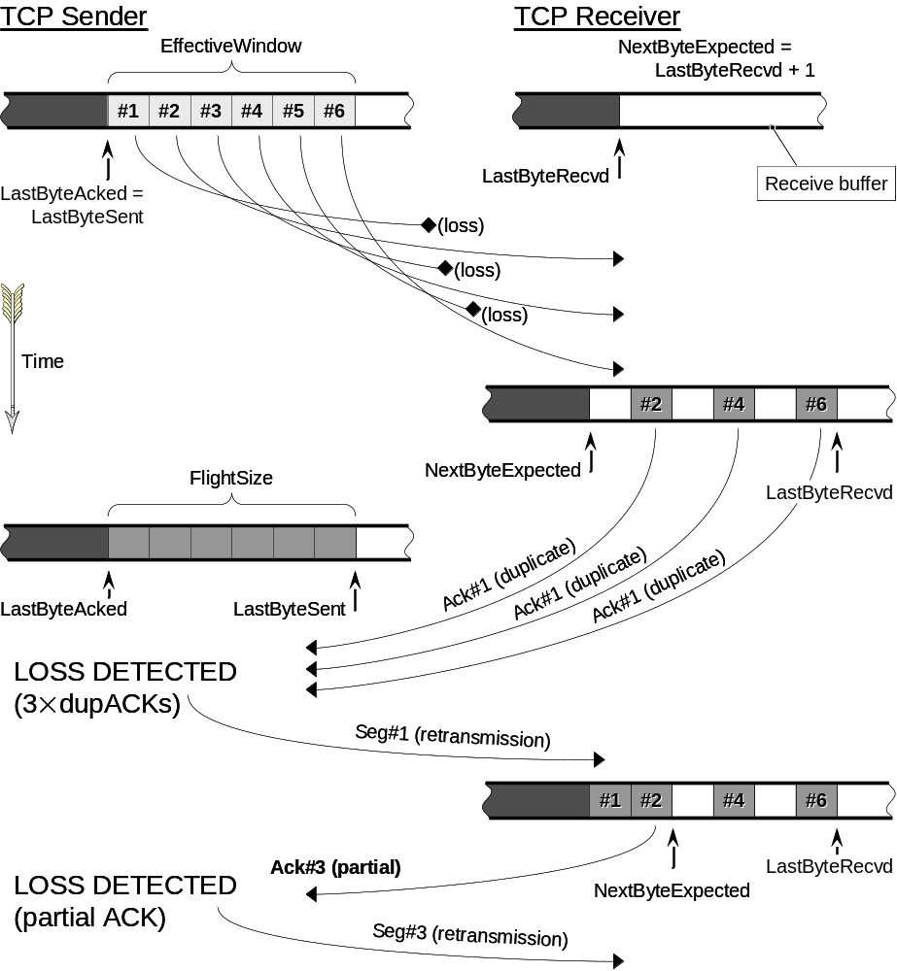
TCP NewReno
t_{loss}
At this time define:
Full acknowledgment =
ACK for all 6 outstanding pkts

Slide 76
TCP Selective ACK (SACK)
TCP with ‘Selective Acknowledgments’ is an extension of TCP Reno
It works around the problems face by TCP RENO and TCP New-Reno, namely detection of multiple lost packets, and re-transmission of more than one lost packet per RTT.
SACK retains the slow-start and fast retransmit parts of RENO. It also has the coarse grained timeout of Tahoe to fall back on, incase a packet loss is not detected by the modified algorithm.

Slide 77
TCP Selective ACK (SACK)
SACK TCP requires that segments not be acknowledged cumulatively but should be acknowledged selectively.
Each ACK has a block which describes which segments are being acknowledged.
The sender has a picture of which segments have been acknowledged and which are still outstanding.

Slide 78
SACK Example
1 - 100
receiver’s buffer
101 - 200
ACK 201
1-100
101-200
201-300
sender
301-400
receiver
401 - 500
501 - 600
ACK 201 SACK 401-601
1-100
101-200
401-500
501-600

Slide 79
Another SACK Example
Receiver Buffer
sender
100-299
receiver
100
299
ACK 300
300-499
300
500
699
500-699
ACK 300, SACK 500-700
700-899
900-1099
300
500
699
900
1099
ACK 300, SACK 900-1100, 500-700
1100-1299

Slide 80
Another SACK Example (cont’d)
300
500
699
900
1099
sender
1100-1299
receiver
300-499
300
500
699
900
1099
ACK 700, SACK 900-1100
700-899
300
500
700
900
1099
ACK 1100
1100

Slide 81
Without SACK vs. With SACK
TCP without SACK
TCP with SACK
sender
100-199
receiver
sender
100-199
receiver
200-299
200-299
ACK 200
ACK 200
300-399
300-399
400-499
400-499
ACK 200
ACK 200, SACK 300-400
500-599
ACK 200
500-599
ACK 200, SACK 300-500
ACK 200
ACK 200, SACK 300-600
fast retransmit
fast retransmit
200-599
200-299
ACK 600
ACK 600

Slide 82
SACK Observations
SACK TCP follows standard TCP congestion control; Adding SACK to TCP does not change the basic underlying congestion control algorithms
SACK TCP has major advantages when compared TCP Tahoe, Reno, and New Reno, as PDUs have been provided with additional information due to the SACK
Difference in behavior when multiple packets are dropped from one window of data
SACK information allows the sender to better decide what to retransmit and what not to

Slide 83
Evolving transport-layer functionality
TCP, UDP: principal transport protocols for 40 years
different “flavors” of TCP developed, for specific scenarios:
Scenario | Challenges
Long, fat pipes (large data transfers) | Many packets “in flight”; loss shuts down pipeline
Wireless networks | Loss due to noisy wireless links, mobility; TCP treat this as congestion loss
Long-delay links | Extremely long RTTs
Data center networks | Latency sensitive
Background traffic flows | Low priority, “background” TCP flows
moving transport–layer functions to application layer, on top of UDP
  HTTP/3: QUIC

Slide 84
QUIC: Quick UDP Internet Connections
application-layer protocol, on top of UDP
  increase performance of HTTP
  deployed on many Google servers, apps (Chrome, mobile YouTube app)
HTTP/2
HTTP/2 (slimmed)
Application
HTTP/3
TLS
QUIC
Transport
TCP
UDP
Network
IP
IP
HTTP/2 over TCP
HTTP/3 over UDP

Slide 85
QUIC: Quick UDP Internet Connections
adopts approaches we’ve studied in this chapter for connection establishment, error control, congestion control
  error and congestion control: “Readers familiar with TCP’s loss detection and congestion control will find algorithms here that parallel well-known TCP ones.” [from QUIC specification]
  connection establishment: reliability, congestion control, authentication, encryption, state established in one (or even zero) RTT (recall HTTP3 discussion in Chapter 2)
multiple application-level “streams” multiplexed over single QUIC connection
  separate reliable data transfer, security
  common congestion control

Slide 86
QUIC: streams: parallelism, no HOL blocking
HTTP
GET
HTTP
GET
HTTP
GET
HTTP
GET
HTTP
GET
application
HTTP
GET
QUIC
encrypt
QUIC
encrypt
QUIC
encrypt
QUIC
encrypt
QUIC
encrypt
QUIC
encrypt
TLS encryption
TLS encryption
QUIC
RDT
QUIC
RDT
QUIC
RDT
QUIC
RDT
QUIC
RDT
QUIC
RDT
error!
QUIC Cong. Cont.
QUIC Cong. Cont.
TCP RDT
TCP RDT
error!
transport
TCP Cong. Contr.
TCP Cong. Contr.
UDP
UDP
(a) HTTP 1.1
(b) HTTP/2 with QUIC: no HOL blocking

Slide 87
Chapter 3: summary
principles behind transport layer services:
  multiplexing, demultiplexing
  reliable data transfer
  flow control
  congestion control
instantiation, implementation in the Internet
  UDP
  TCP
Up next:
leaving the network “edge” (application, transport layers)
into the network “core”
two network-layer chapters:
  data plane
  control plane

